Slide 1
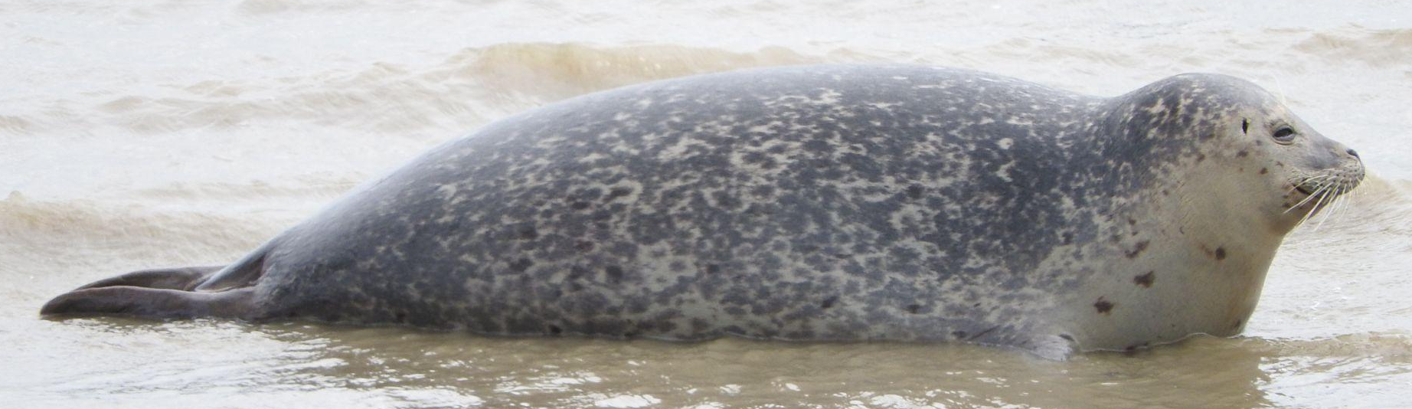
Aiding the photo-identification process for harbour seals (Phoca Vitulina)
Matej Kučera

Slide 2
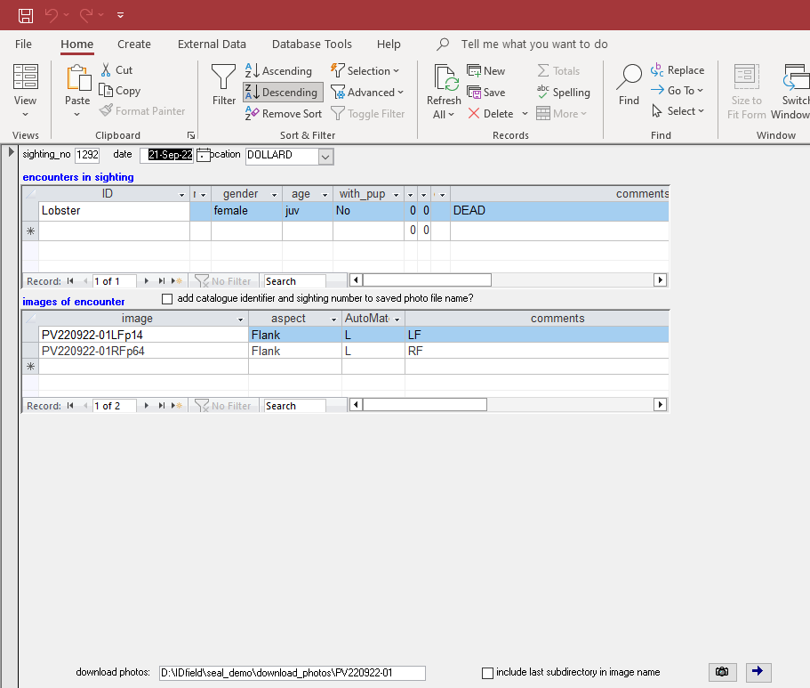
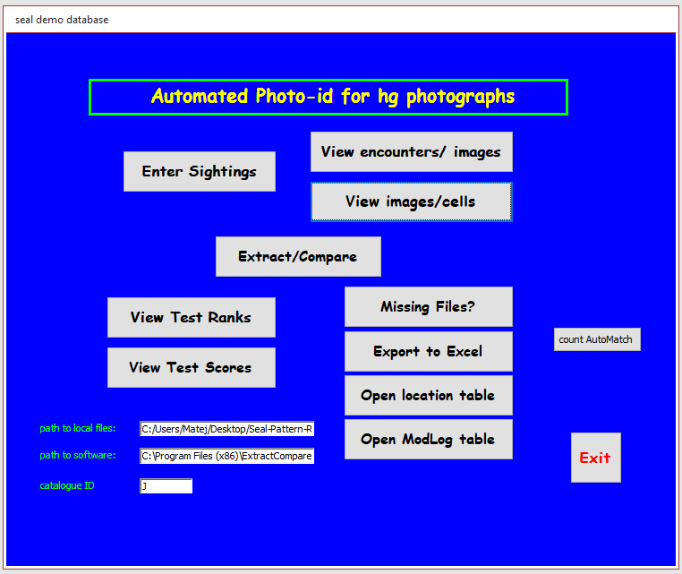

The old way - ExtractCompare

Slide 3
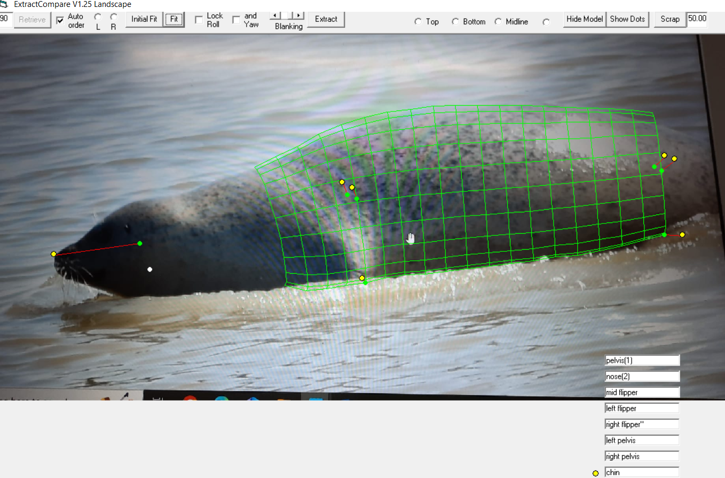
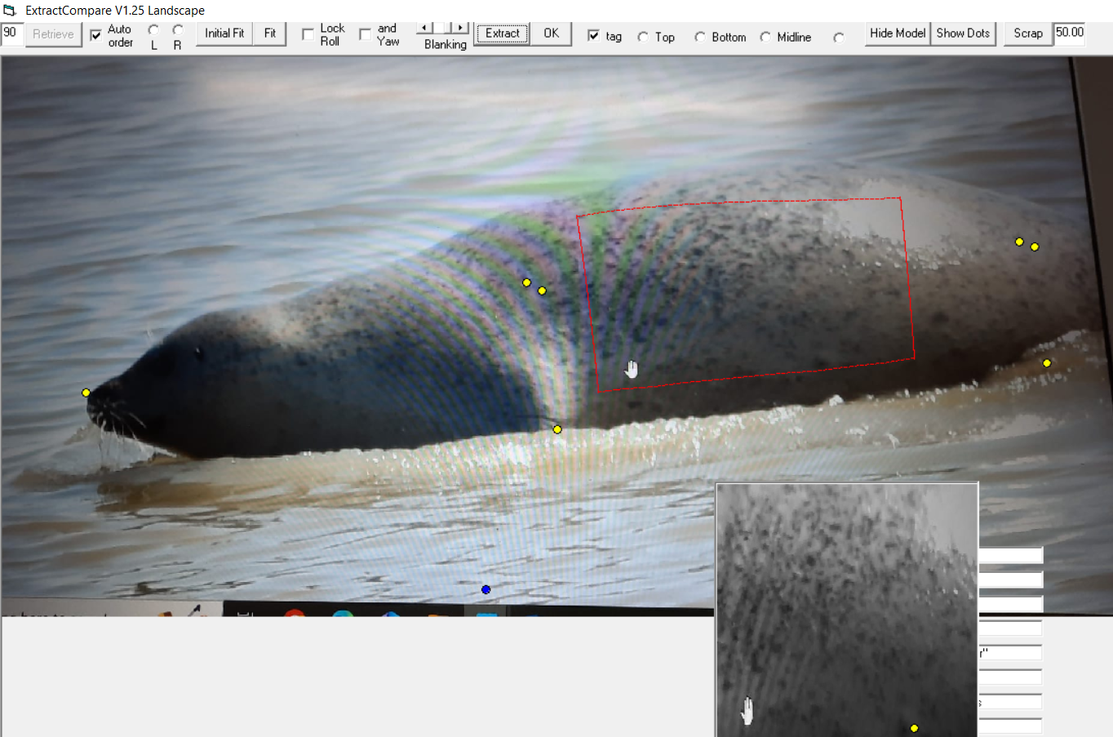
The old way - ExtractCompare

Slide 4
Research questions
What is the best way to convert multiple ExtractCompare-based databases to Wildbook?
What needs to be done in order to deploy Wildbook at Zeehondencentrum Pieterburen?
How does the algorithm used by Wildbook compare to ExtractCompare?
What documentation is necessary for the software created?

Slide 5
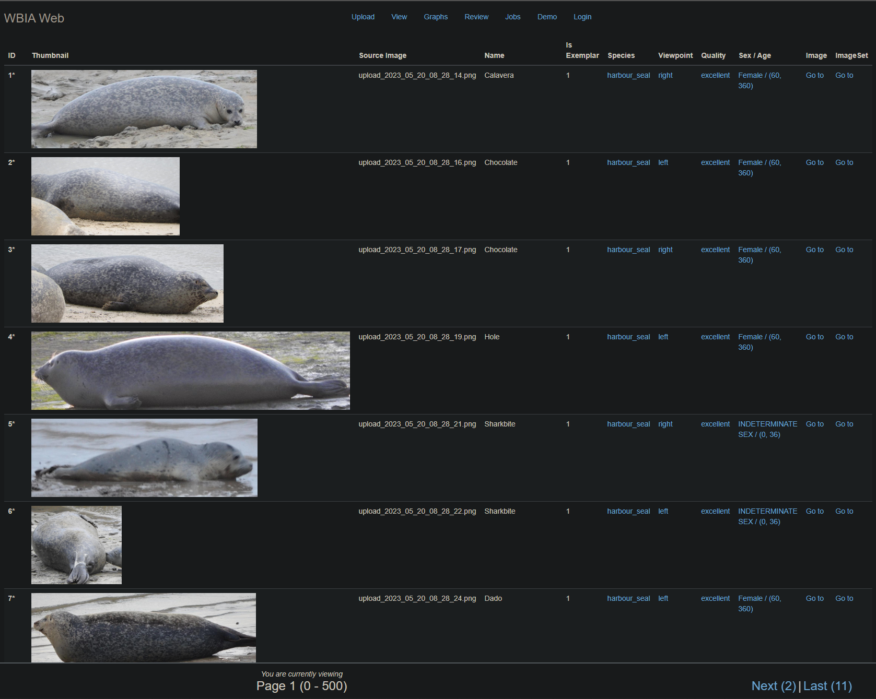

Wildbook
More accurate
Easier to use
Open-source
Actively maintained

Slide 6
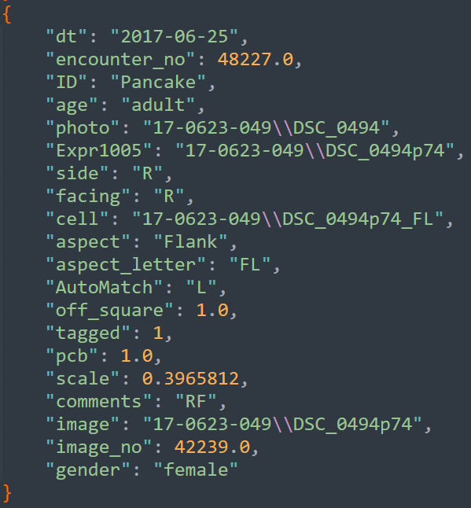
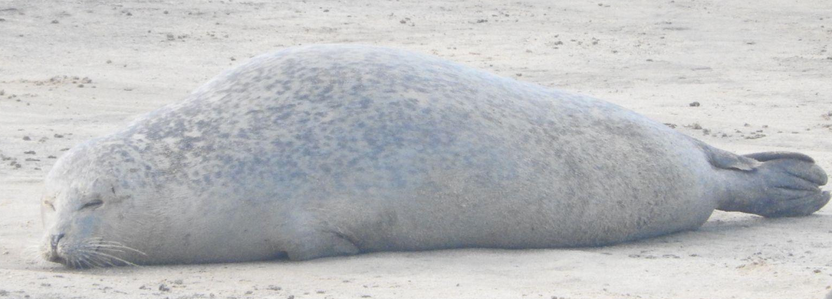
Database conversion process
Export to Excel
Read into Python
Upload using API
Detect
Match
All seals live at the same elevation. Seal level.

Slide 7
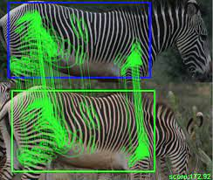
Matching algorithm
HotSpotter
SIFT - Scale Invariant Feature Transform
keypoint descriptor vectors
LNBNN - Local Naive Bayes Nearest Neighbor

Slide 8
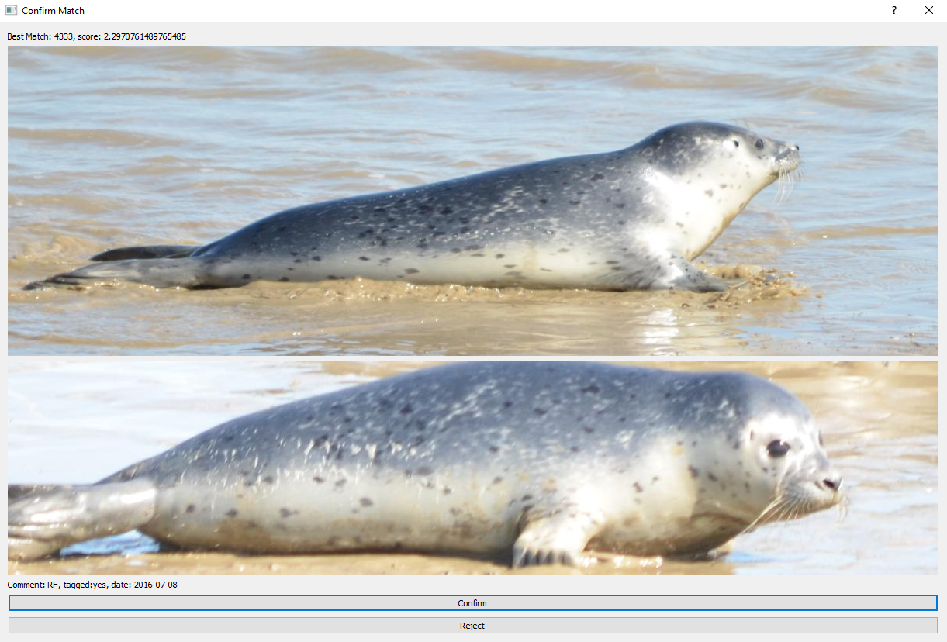
Notes:
Todo: add transitions to arrows

Slide 9
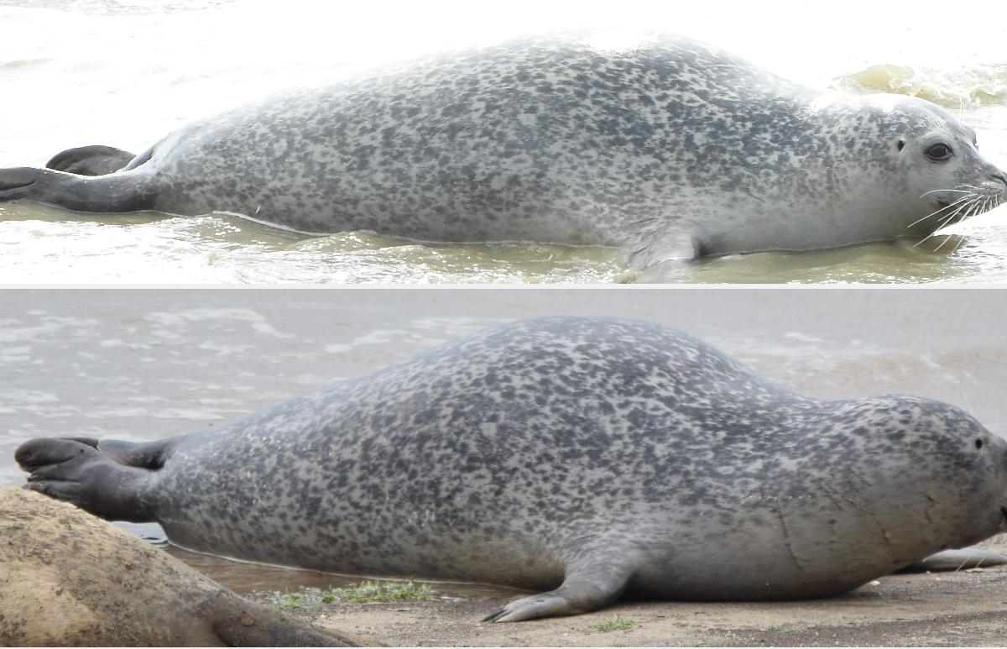

Slide 10
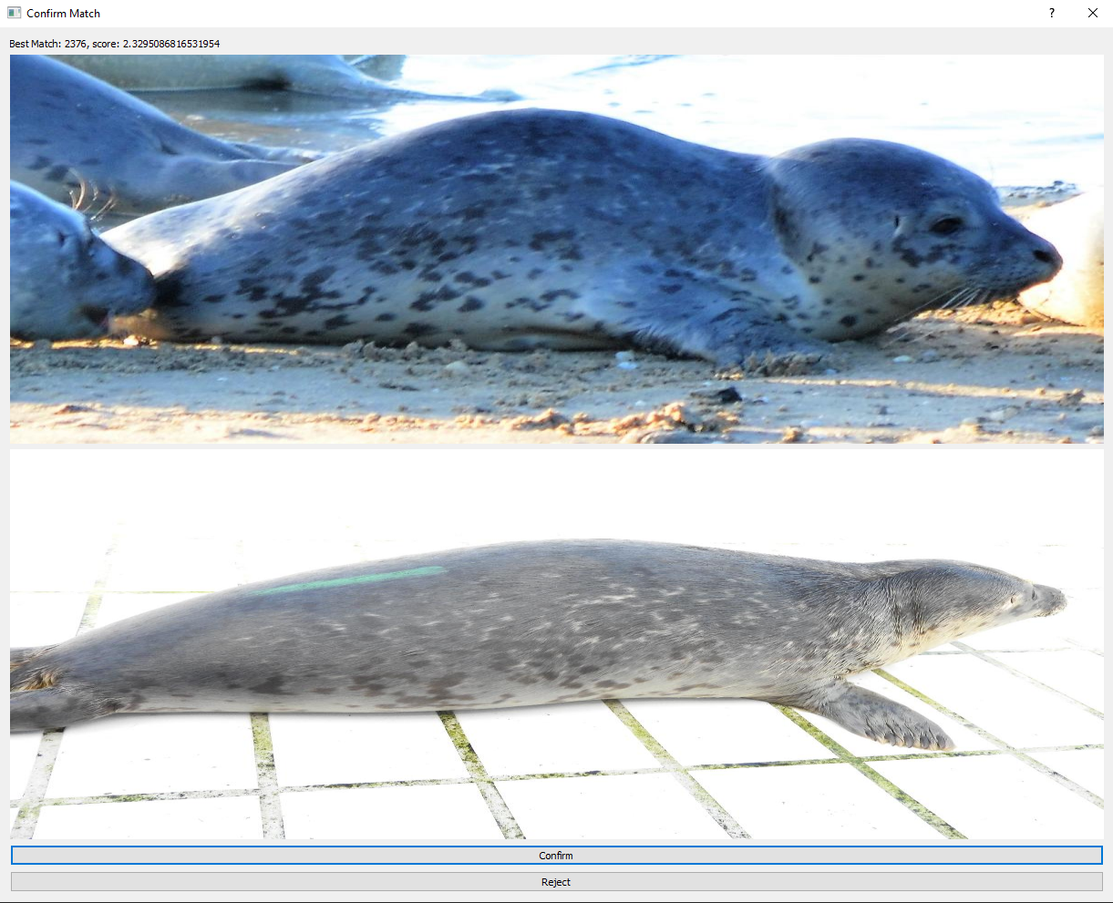

Slide 11
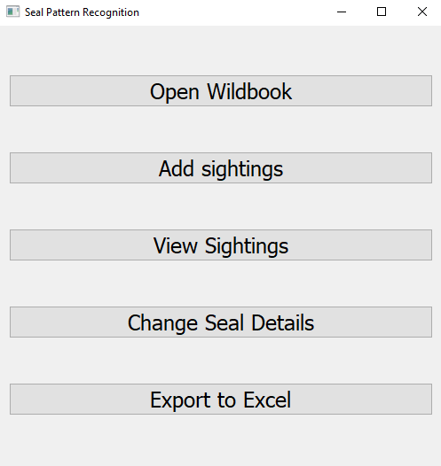
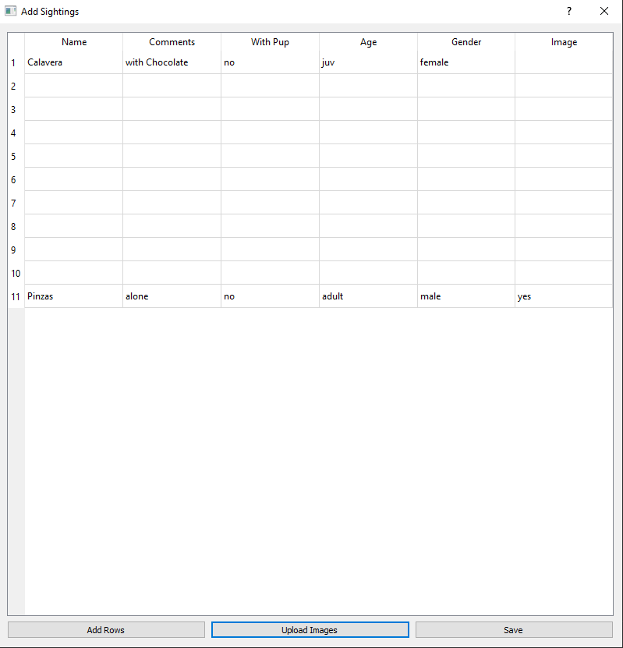
The new app

Slide 12
The new app

Slide 13
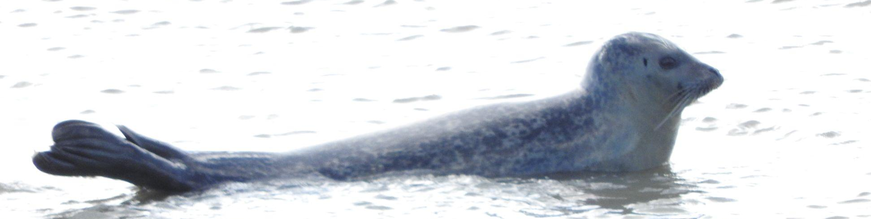
Thank you for your attention
Have a fin-tastic afternoon

